Slide 1
NEZ ‘Population’ study of NH₃, CH₄ (619 nm), & WINJupos dark projections & festoons
Hypothesis: Plumes and dark formations (presumably 5-micron hot spots) represent a source-sink pair for gaseous NH₃.
NH₃ enhancements and CH₄ ‘deep clouds’ from current analysis analyzed for:
Location relative to each other: NH₃ enhancements appear distributed around a centroid ~3.9 deg S and ~0.8 deg W of dark formations .
Deep cloud locations match very closely with WinJUPOS dark projections & festoon locations.
Distribution of relative locations compared to flow diagram around ‘hot spots’ (Choi et al., 2013).
Individual examples of NH₃ distribution relative to deeper clouds associated with dark formations.

Slide 2
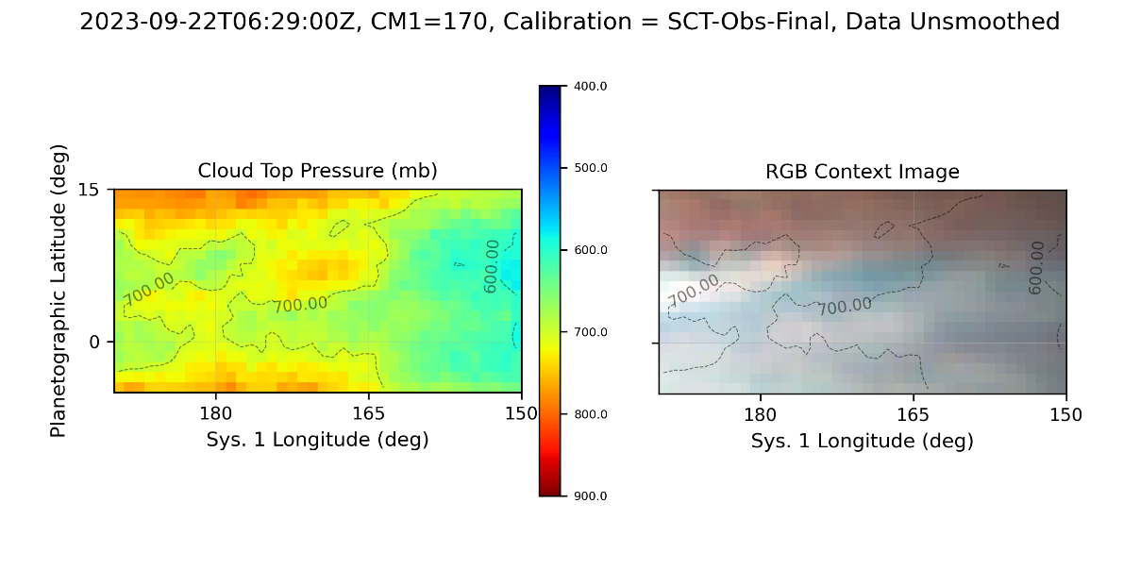
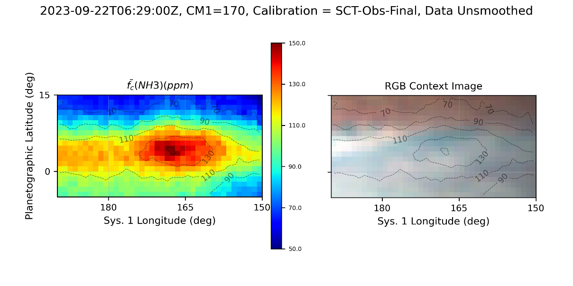
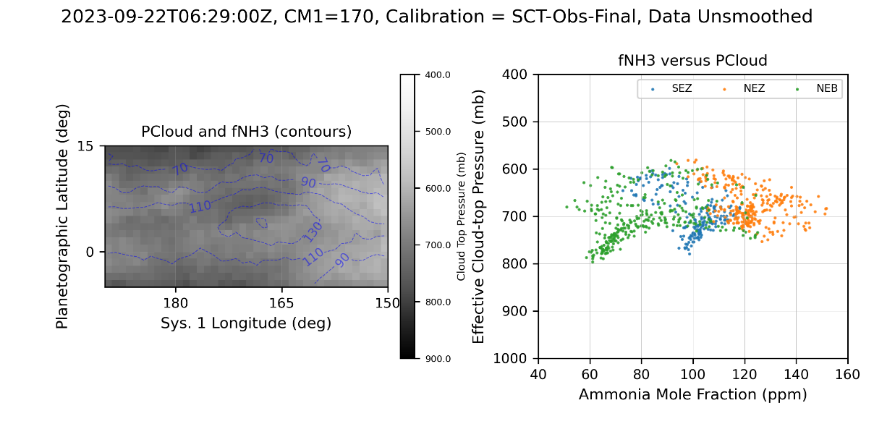
NH₃ enhancements and CH₄ Deep Clouds
a)
Effective cloud top pressure determined by CH₄ absorption. Contours show cloud top pressure overlaid on a contemporaneous optical context image.
Ammonia column-averaged abundance derived from the ratio of ammonia to methane absorption images. Contours show cloud top pressure overlaid on a contemporaneous optical context image.
Left: Effective cloud-top pressure rendered as grey scale with ammonia abundance contours. Right: Scatter plot of effective cloud-top pressure versus ammonia mole fraction by latitude band.
b)
Ninety-one NH₃ and CH₄ observations from 2022-07-30 through 2024-01-30
2022 Apparition: 18 with SCT, 2 with VLT
2023 Apparition: 70 with SCT
175 CH₄ cloud holes / deep clouds
180 NH₃ enhanced regions
Dark Projections & Festoons from WinJUPOS
Total 7082 positions between 2022-06-01 and 2023-11-22
c)

Slide 3
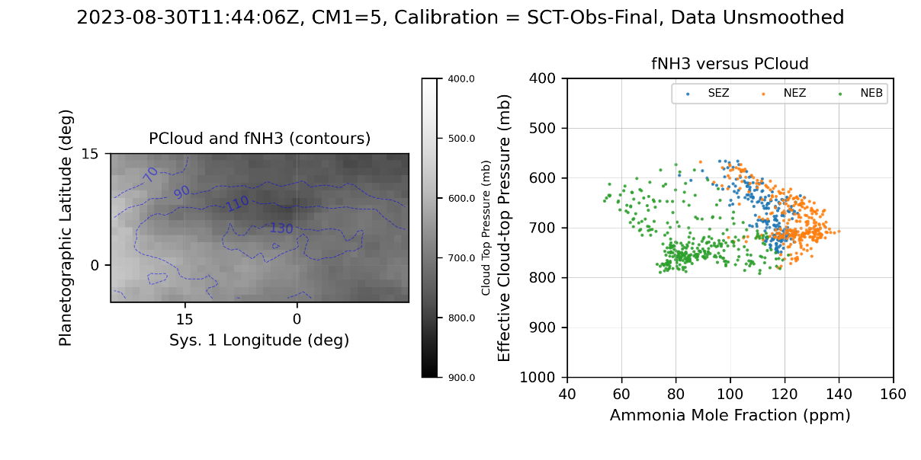
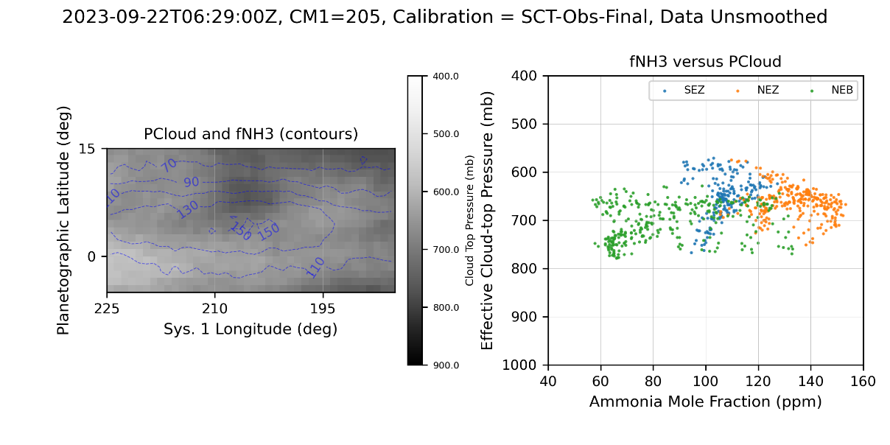
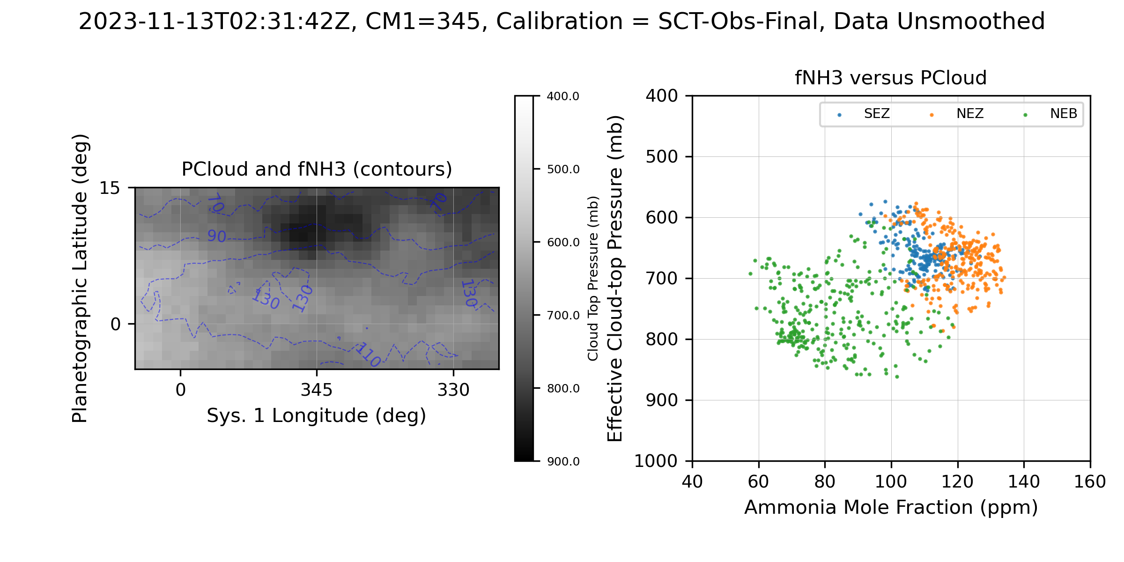
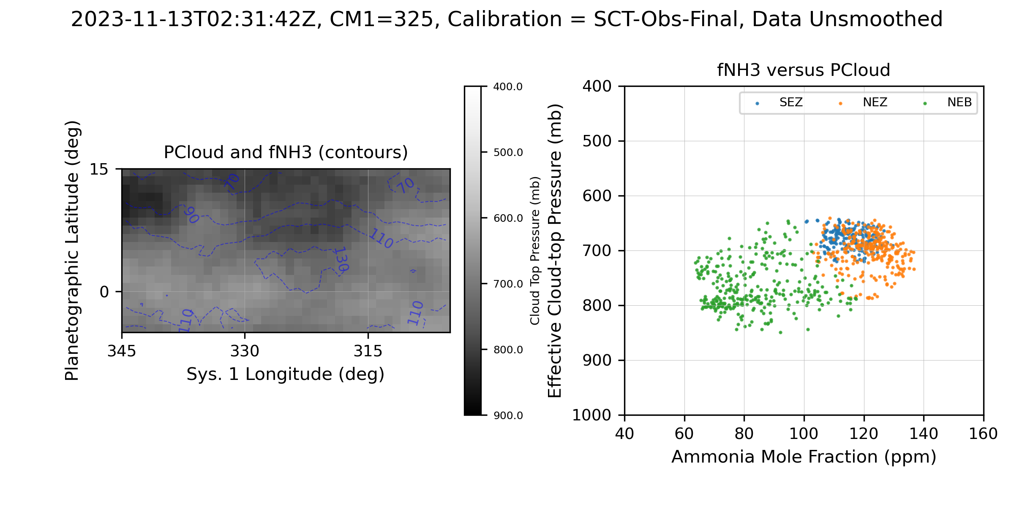
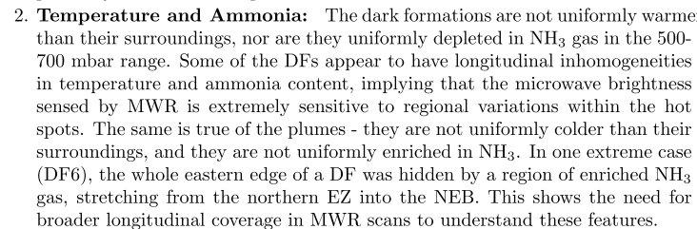
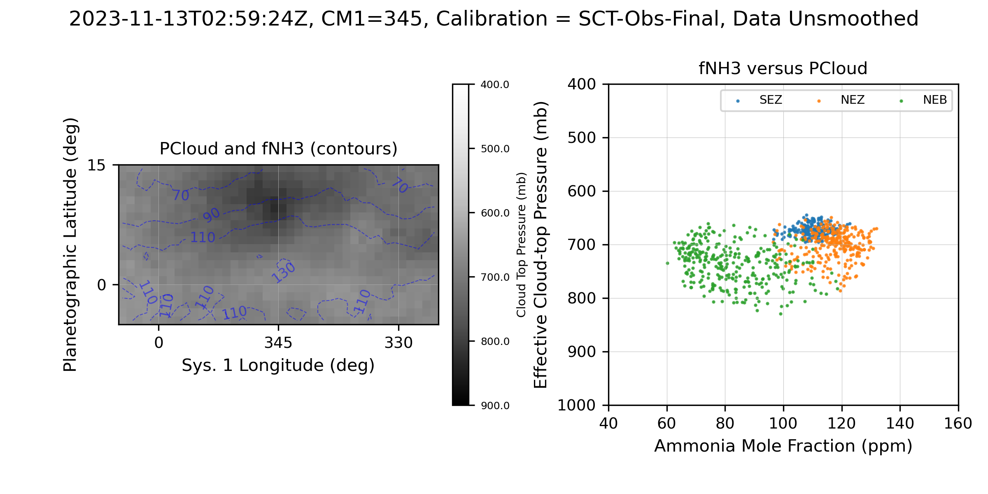
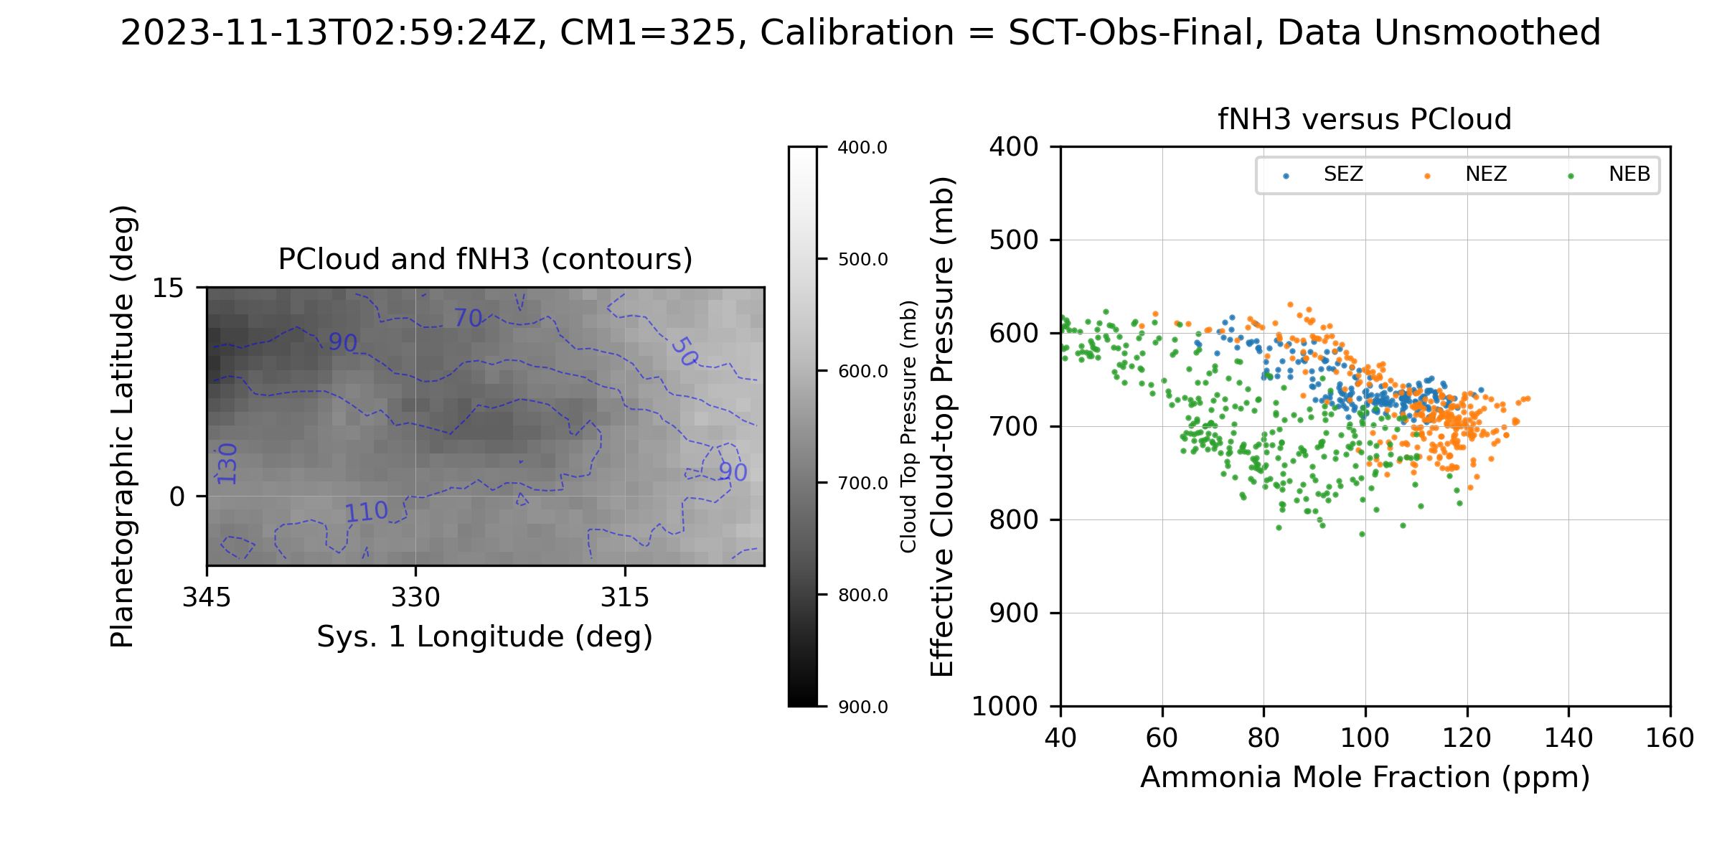
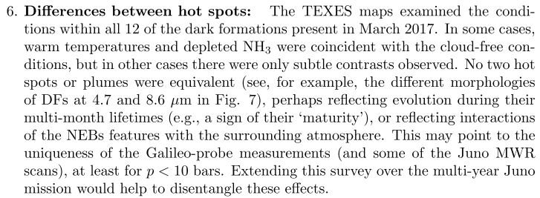
a)
b)
Additional Examples
Spatial resolution is 1-2 arcsec, which translates to about 3-6 deg of latitude.
a-b) show two different regions on different dates
c-d) and e-f) show the same two regions observed 30 mins apart on 2023-11-13. Note that e) was close relatively close to the limb.
Note the variations measured in the MIR showing that ammonia enhancements and depletions are not always directly correlated with hotspots and plumes (Fletcher et al., 2020, excerpts below).
c)
d)
e)
f)

Slide 4
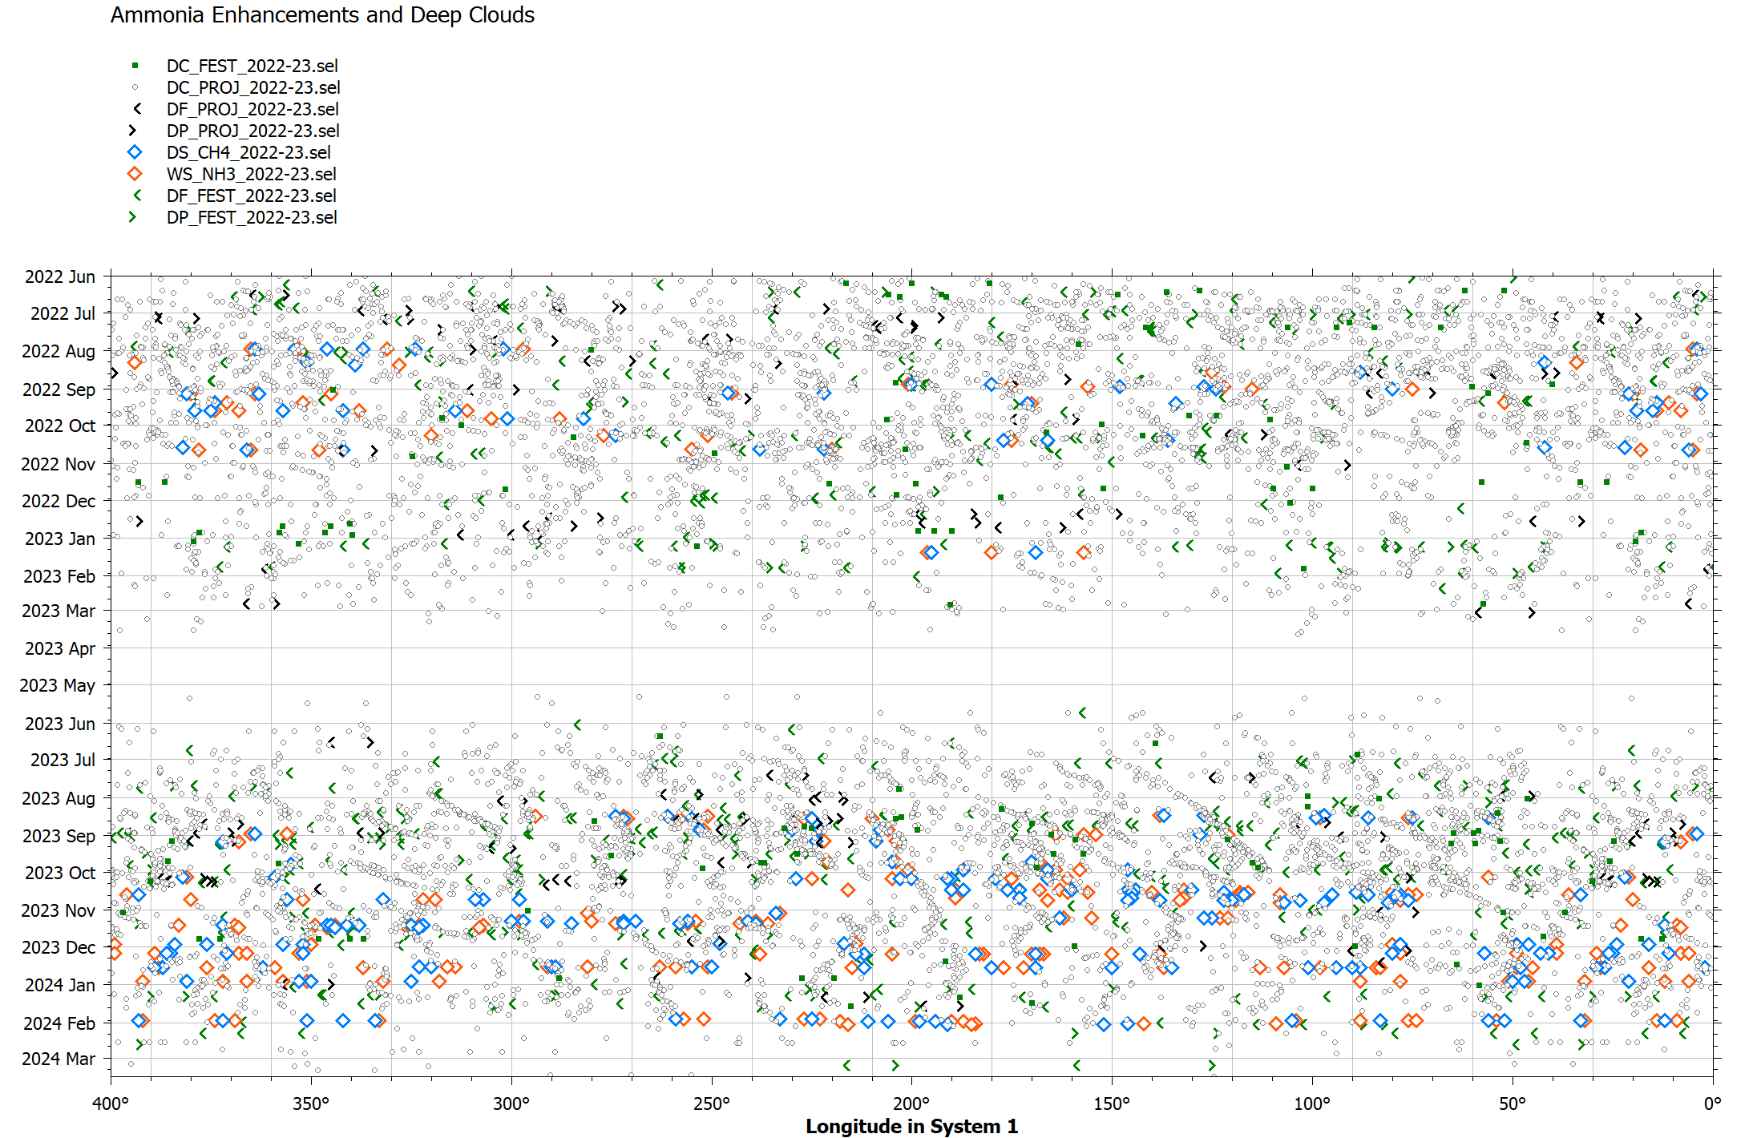
NH₃ and CH₄ Features in Context with WinJUPOS Dark Formations
Centroids of NH₃ enhancements and CH₄ (619nm) deep clouds were measured by visual inspection and entered into WINJupos
Latest release (2024-05-24) of JUPOS measurements of Dark Projections and Festoons

Slide 5
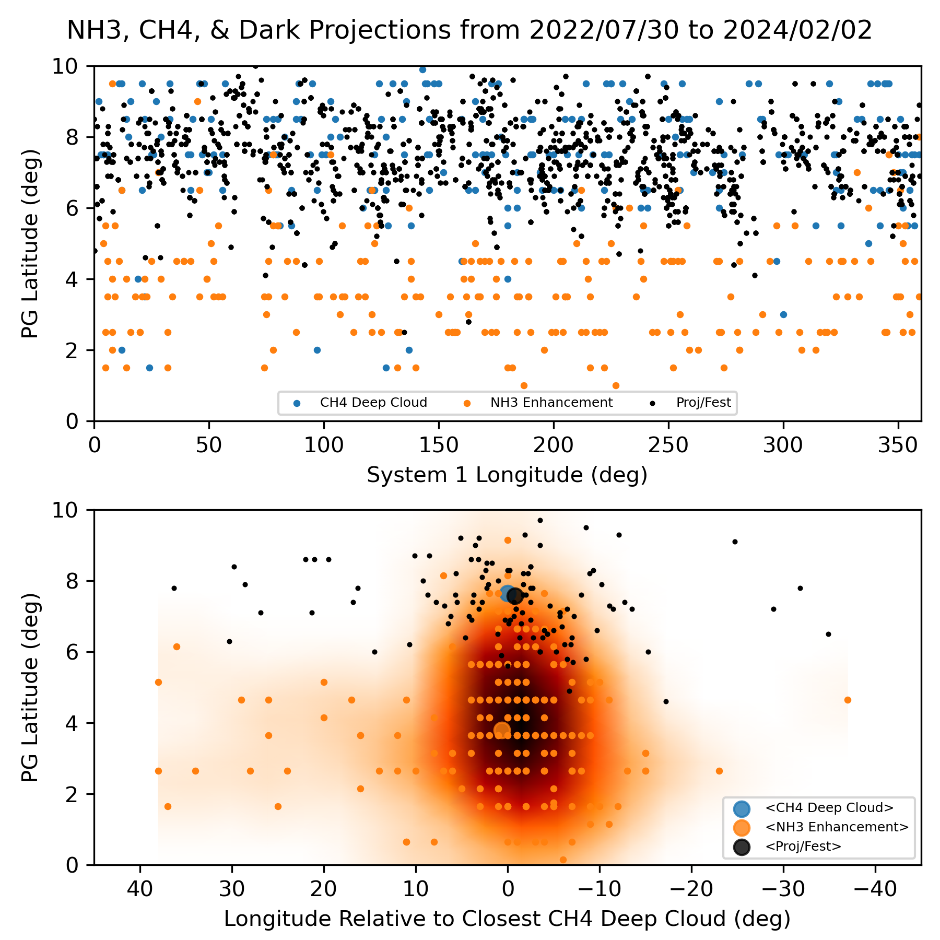
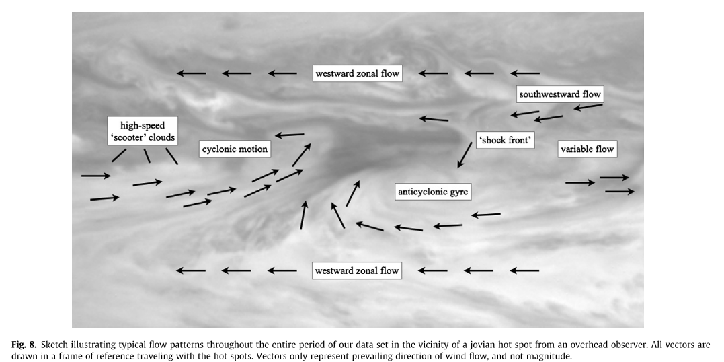
Relative Locations of Deep Clouds, Dark Features, and NH₃ Enhancements
a) NH₃ enhancements, CH₄ deep clouds, and projections/festoons from same UT day are plotted.
b) Same as a), but plotted with longitude relative to closest CH₄ deep cloud and density map of NH₃ relative locations overlaid.
c) Typical flow patterns near around a hot spot (Choi et al., 2013, Fig. 8).
Suggests NH₃ enhancement generally occurs near the anticyclonic gyre and/or westward zonal flow.
a)
c)
b)

Slide 6
Evolution of NEDF/NH3 Enhancements
Hypothesis 1: Ammonia enhancements span the SE boundary between NEDFs and plumes because plume material (NH3 ice) is evaporating as the plume dissipate. Therefore, there should be correlation between plume location at some earlier time offset (days?) and the current NH3 enhancement location. To disambiguate between simple advection of the NEDF-Plume-NH3 ‘complex,’ we need to find different configurations of NEDFs and Plumes, i.e., not just the NW-SE orientation. This would also demonstrate that the plumes correlated with NH3 evaporation contain aerosols that are indeed composed, at least partially, of NH3.
NH3 enhancements tracked relative to NEDFs over time
Show evolution of NEDF-NH3 couple

Slide 7
Evolution of NEDF/NH3 Enhancements
Hypothesis 2: Convergent flow in the anticyclonic gyre
NH3 enhancements tracked relative to NEDFs over time
Show evolution of NEDF-NH3 couple

Slide 8
Evolution of NEDF/NH3 Enhancements
Hypothesis 3: Seeing more deeply into the NEDF than adjacent plume
NH3 enhancements tracked relative to NEDFs over time
Show evolution of NEDF-NH3 couple

Slide 9
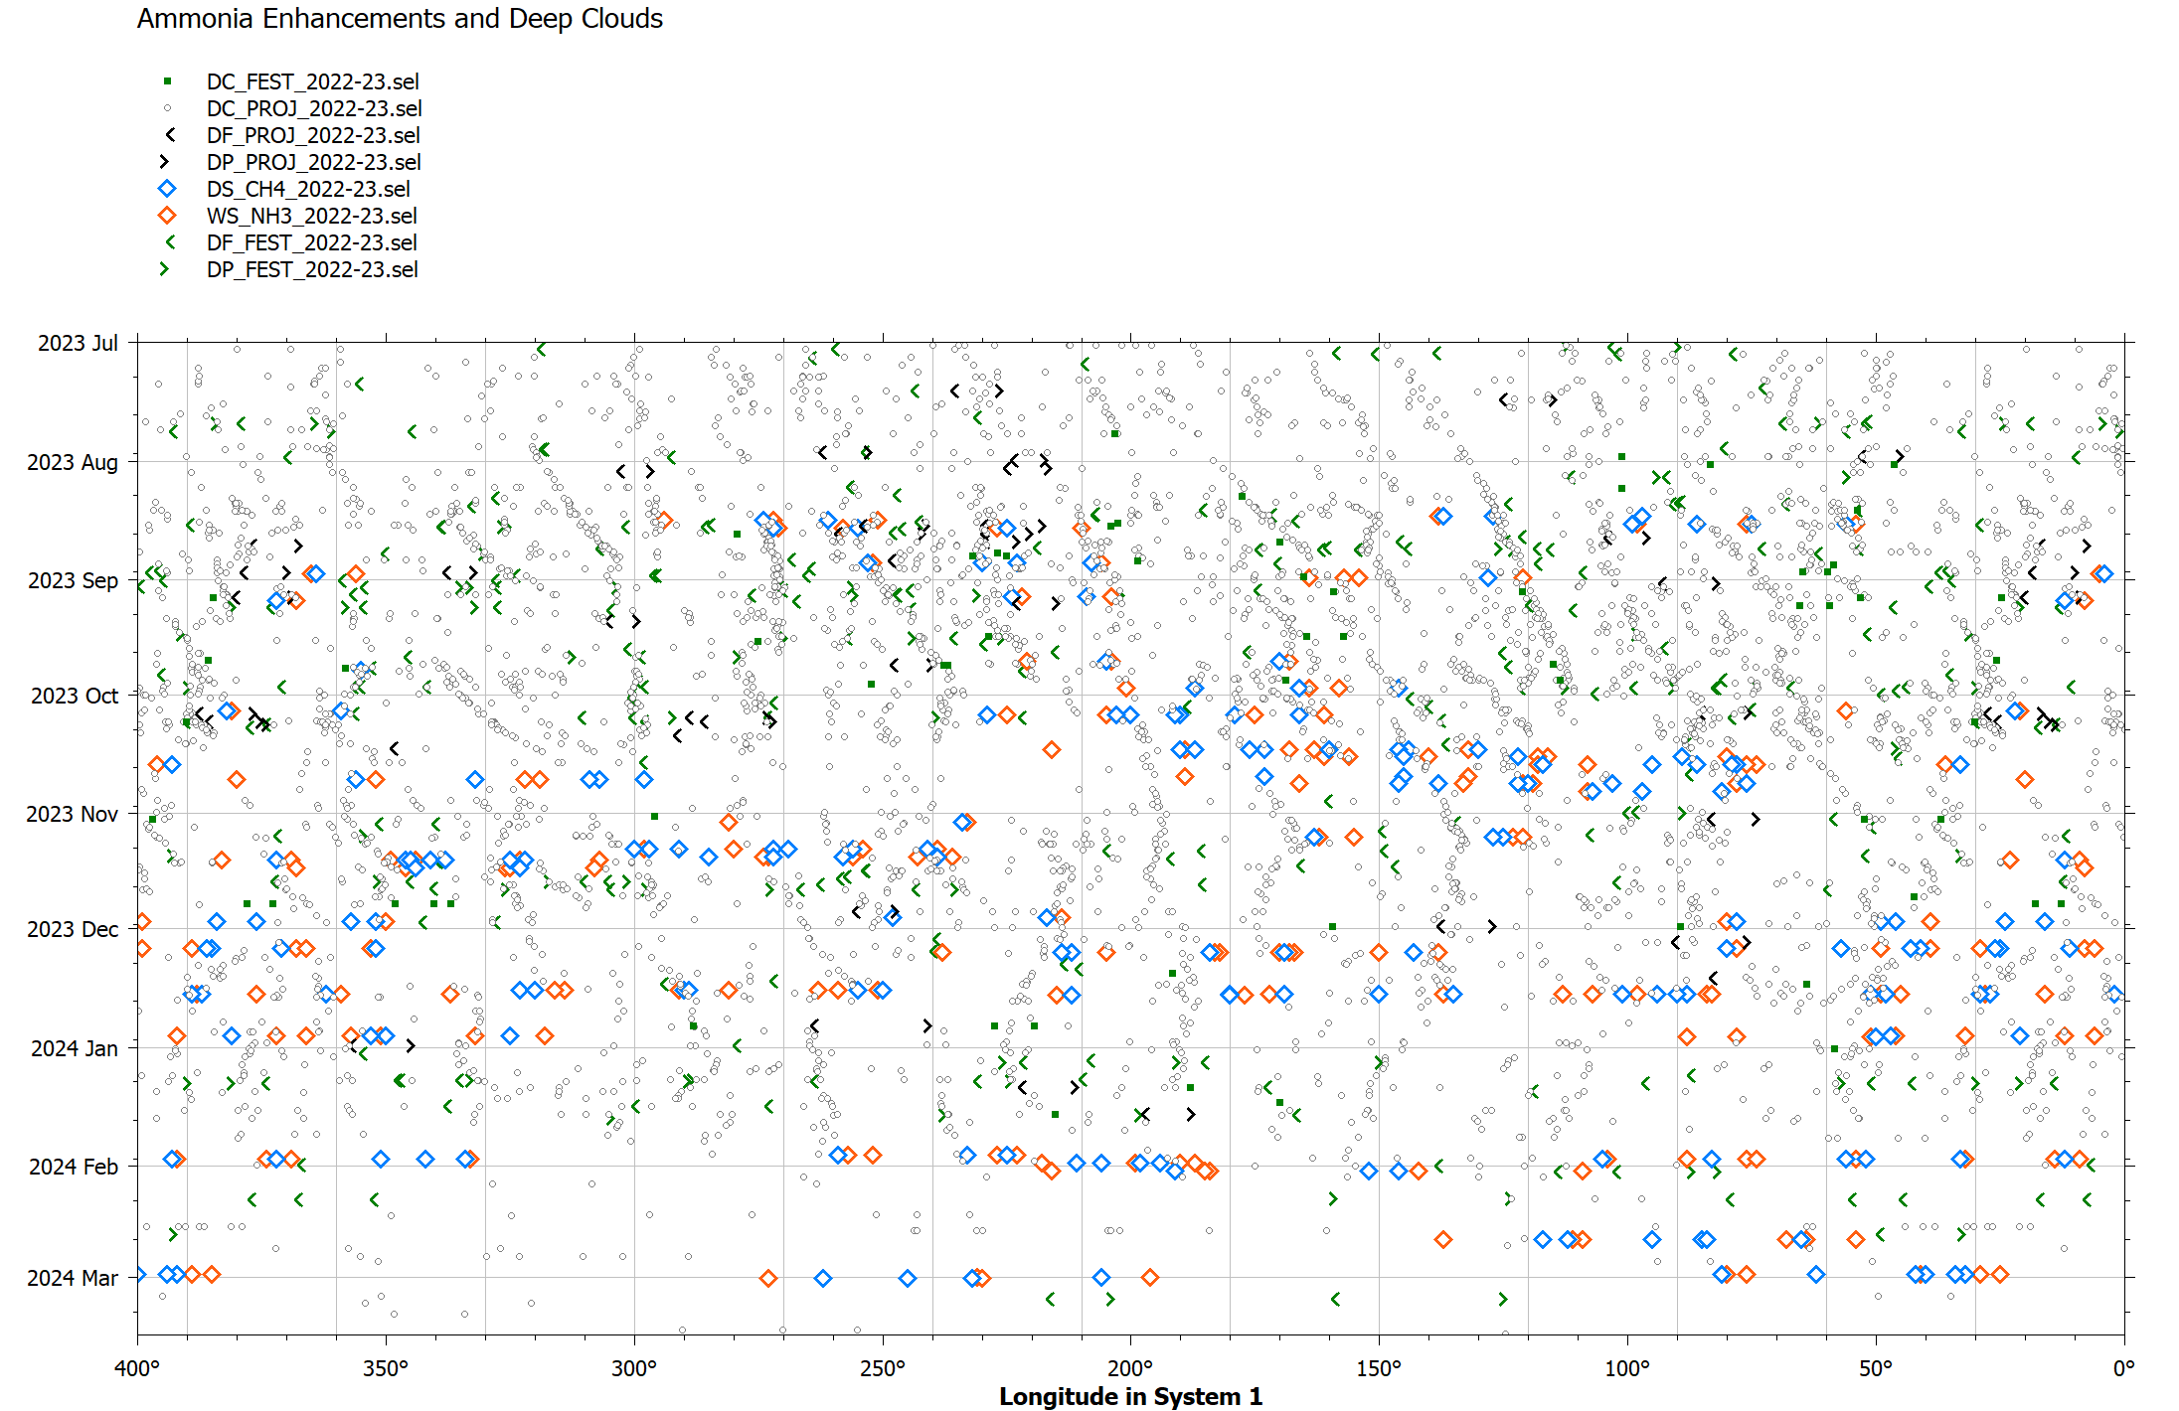
NH₃, CH₄, and NEDFs Candidates for Study
Time Evolution: ~200 deg from August to October (possibly connected to Feb 2024 observations)
~220 deg same time period
Nov 13 ~350 deg

Slide 10
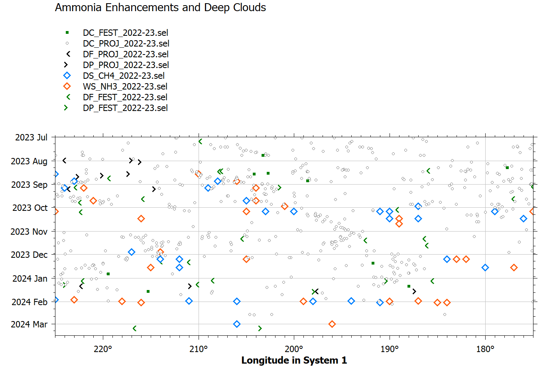
NH₃, CH₄, and NEDFs Near 200 deg Sys 1
ObsID | NH3 Time | CM1 | CM2 | CM3 | Telescope
20230818UTa | 2023-08-18_11:37:06 | 241.2 | 250.8 | 268 | C11
20230827UTa | 2023-08-27_11:30:36 | 218.6 | 159.5 | 179.1 | C11
20230905UTa | 2023-09-05_11:38:18 | 204.8 | 77.1 | 99.1 | C11
20230905UTb | 2023-09-05_12:05:12 | 221.2 | 93.3 | 115.4 | C11
20230922UTa | 2023-09-22_06:29:00 | 182 | 286.1 | 312.6 | C11
20230929UTa | 2023-09-29_05:32:12 | 173.4 | 224.5 | 252.8 | C11
20231006UTa | 2023-10-06_05:04:42 | 182.8 | 180.6 | 210.8 | C11
20231006UTb | 2023-10-06_05:35:24 | 201.5 | 199.1 | 229.3 | C11
20231015UTb | 2023-10-15_05:22:36 | 176 | 105 | 137.6 | C11
20231207UTb | 2023-12-07_03:14:48 | 192.2 | 77.5 | 124.2 | C11
20231207UTc | 2023-12-07_03:43:42 | 209.8 | 95 | 141.7 | C11
20231218UTf | 2023-12-18_05:13:06 | 201.2 | 1.9 | 51.5 | C11
20240131UTa | 2024-01-31_02:22:30 | 199.9 | 25.9 | 87.1 | C11
20240131UTb | 2024-01-31_02:49:06 | 216.1 | 41.9 | 103.2 | C11
20240202UTb | 2024-02-02_03:19:30 | 190 | 0.5 | 62.3 | C11

Slide 11
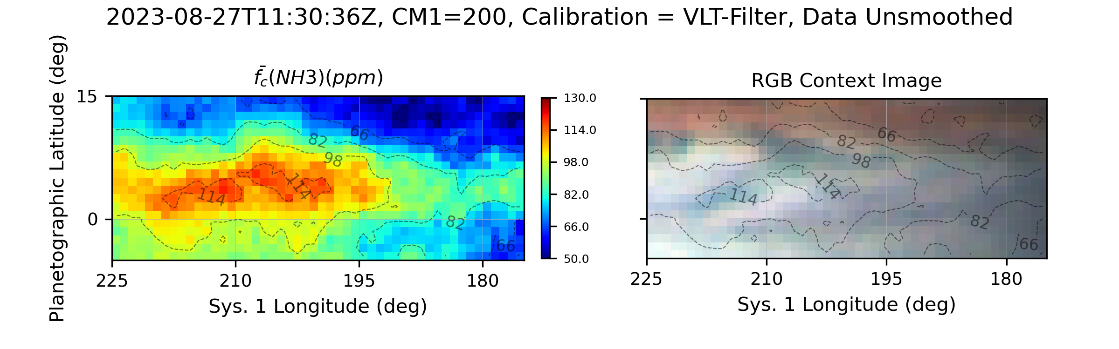
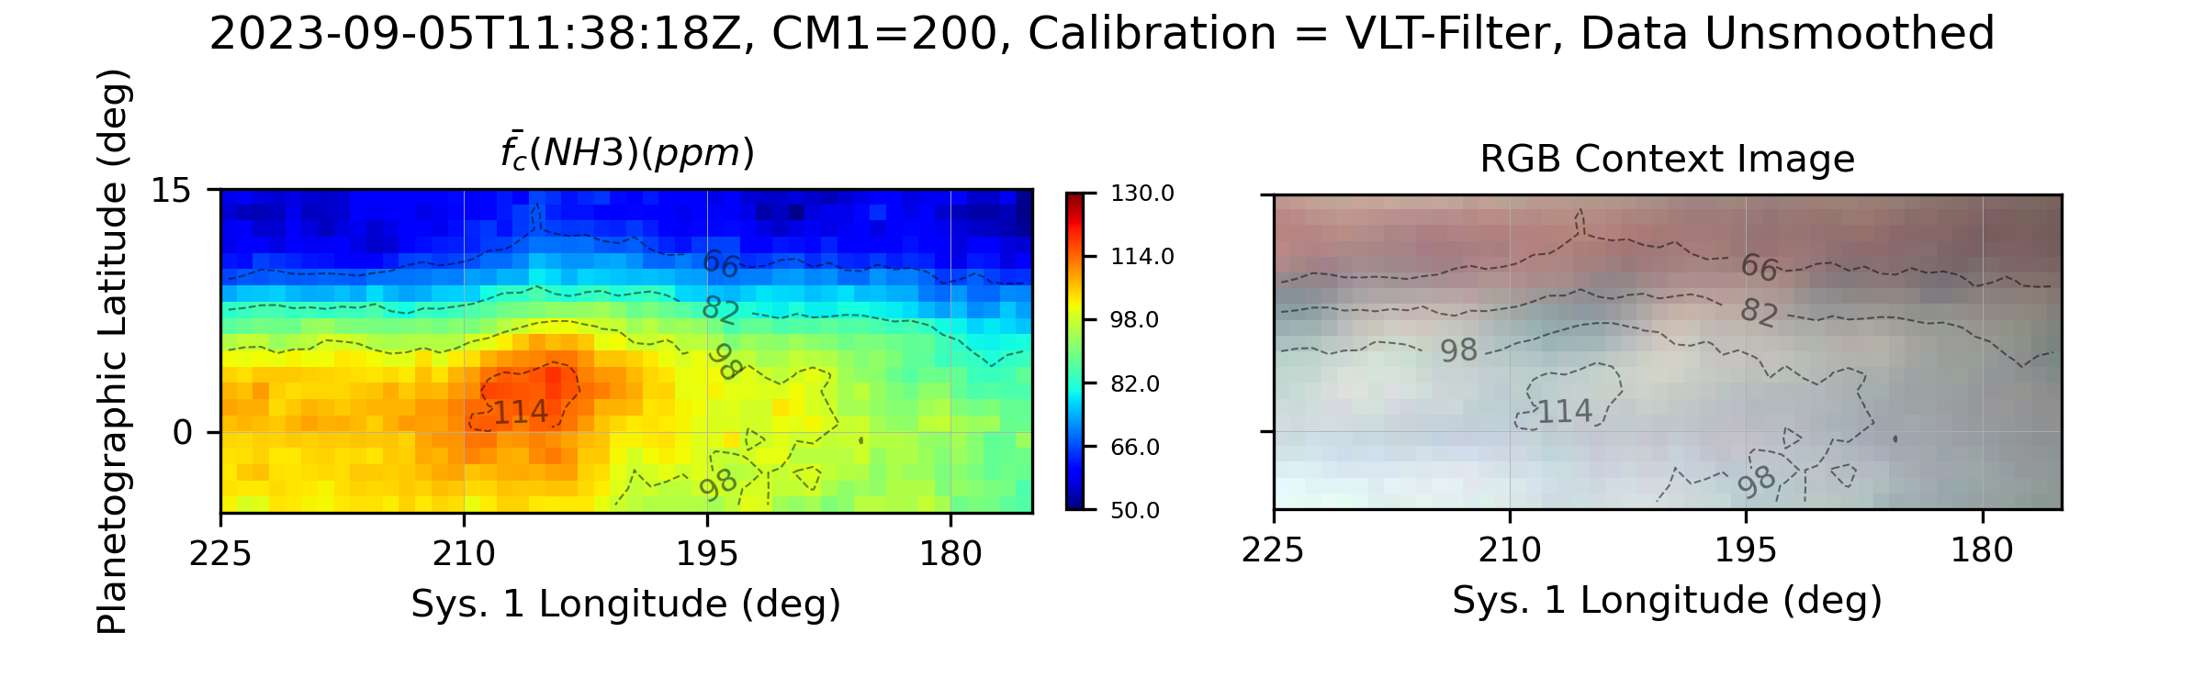
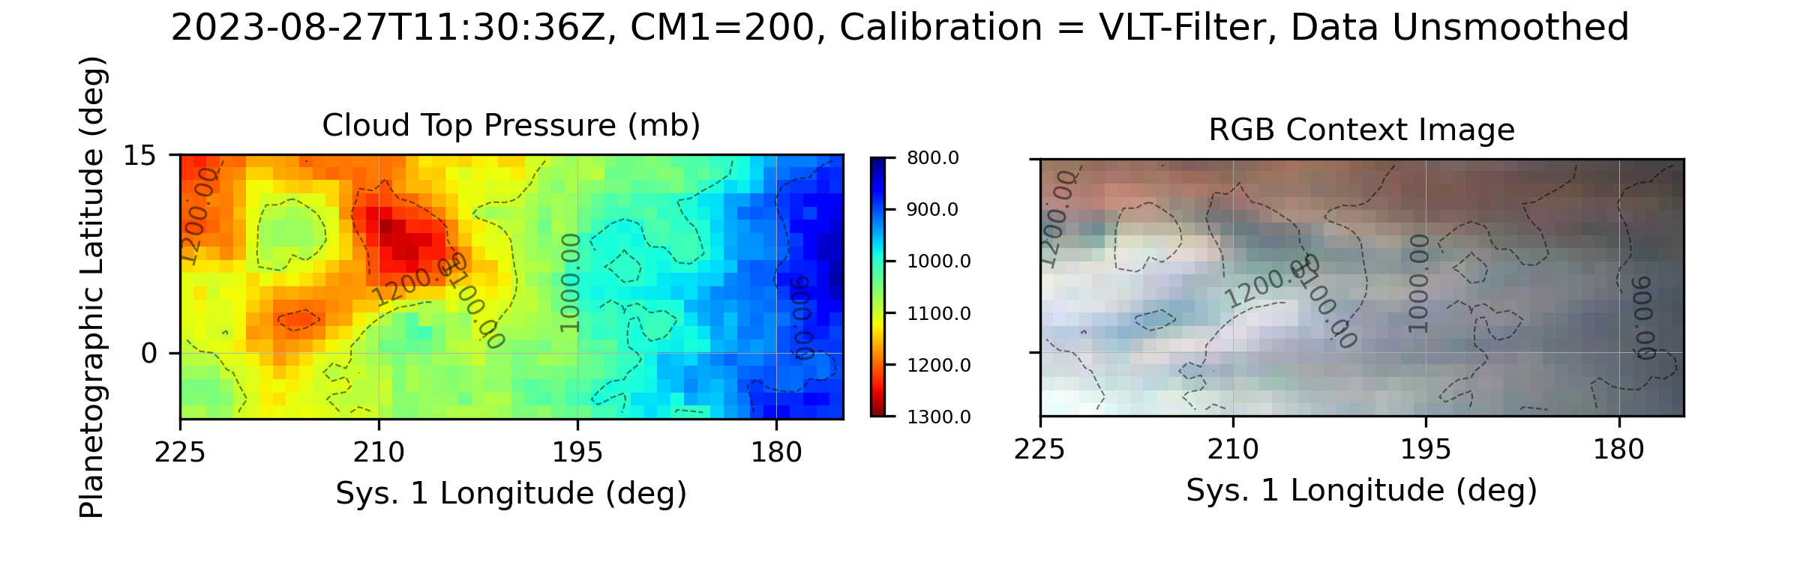
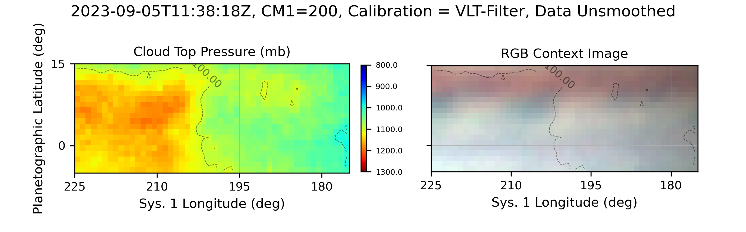
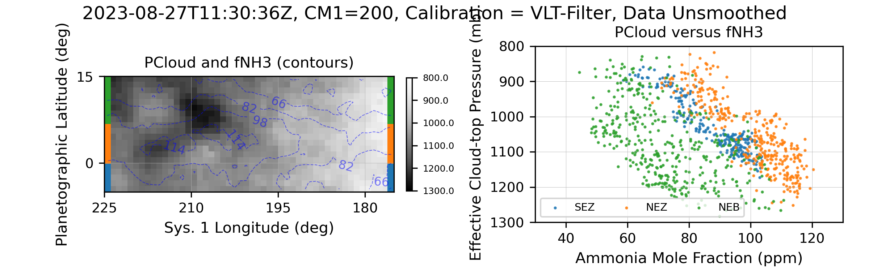
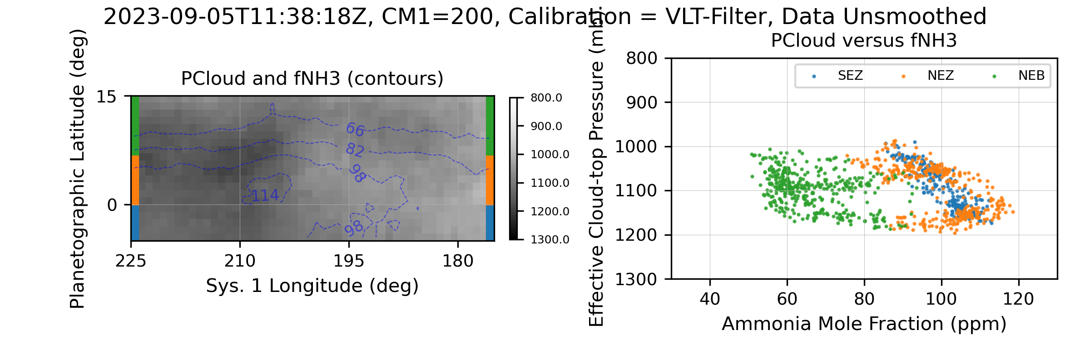
NH₃, CH₄, and NEDFs Candidates for Study
Time Evolution: ~200 deg from August to October (possibly connected to Feb 2024 observations)
~220 deg same time period
Nov 13 ~350 deg

Slide 12
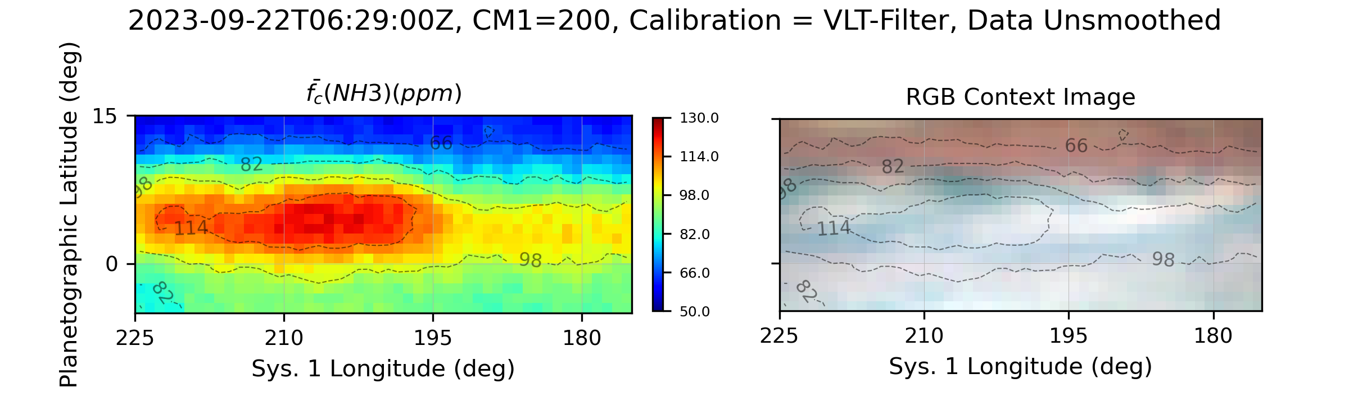
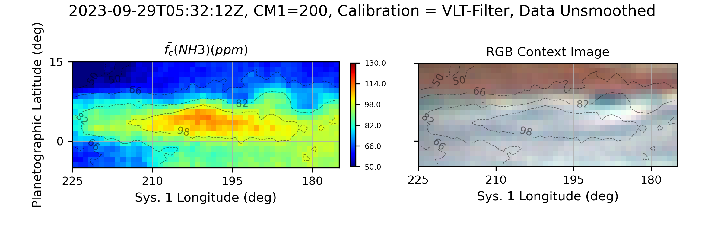
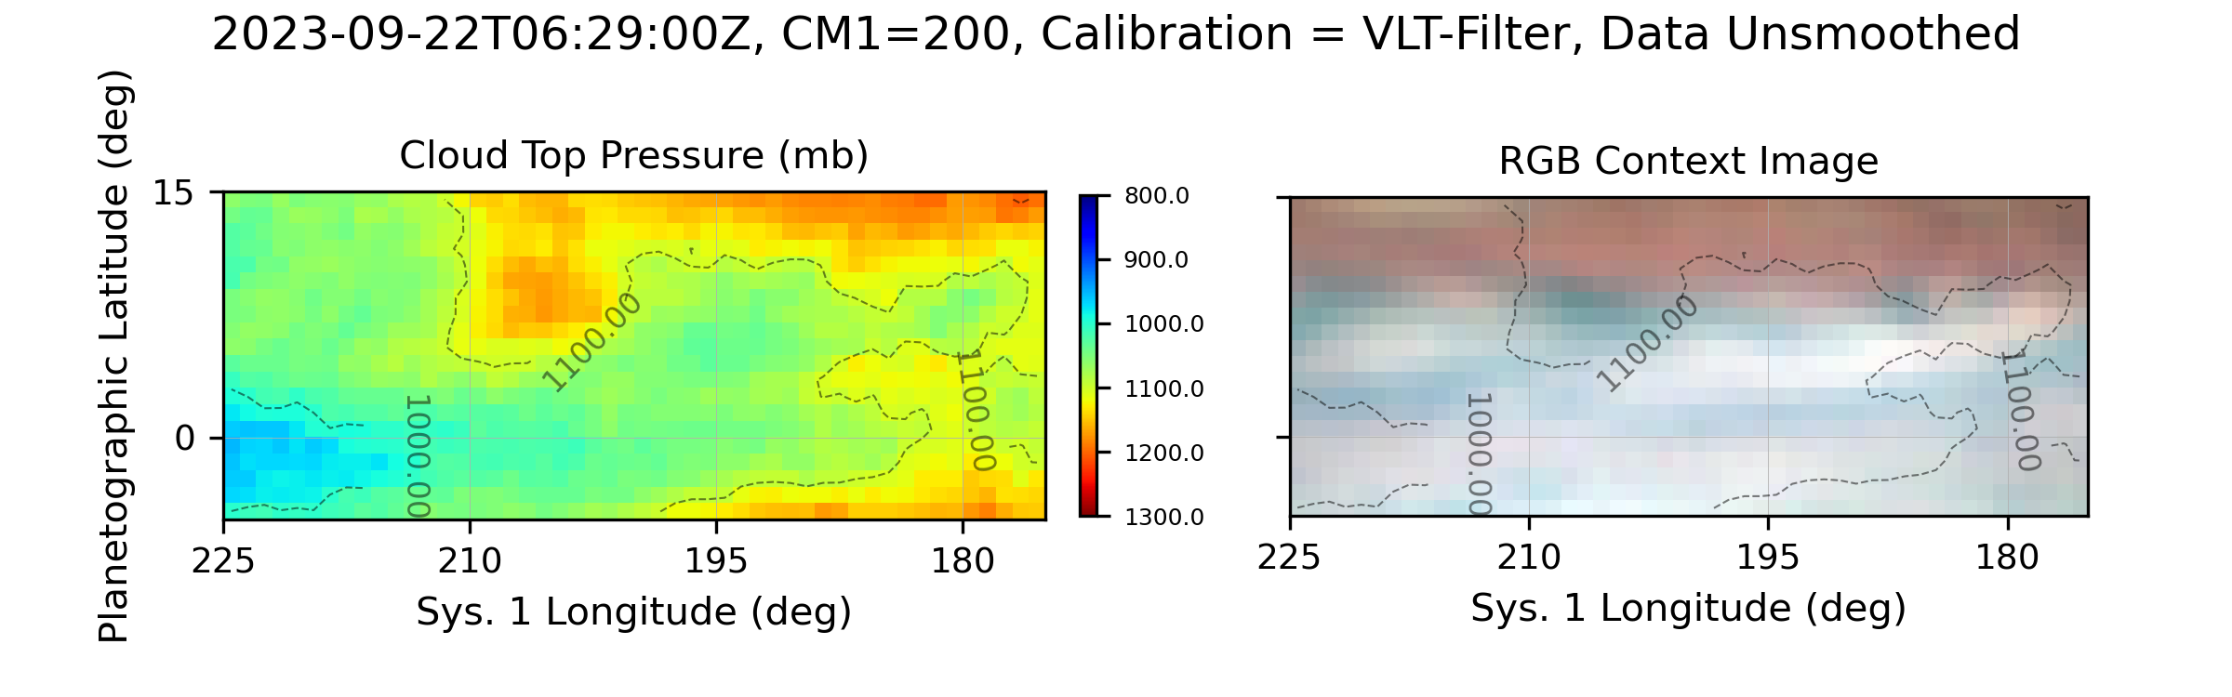
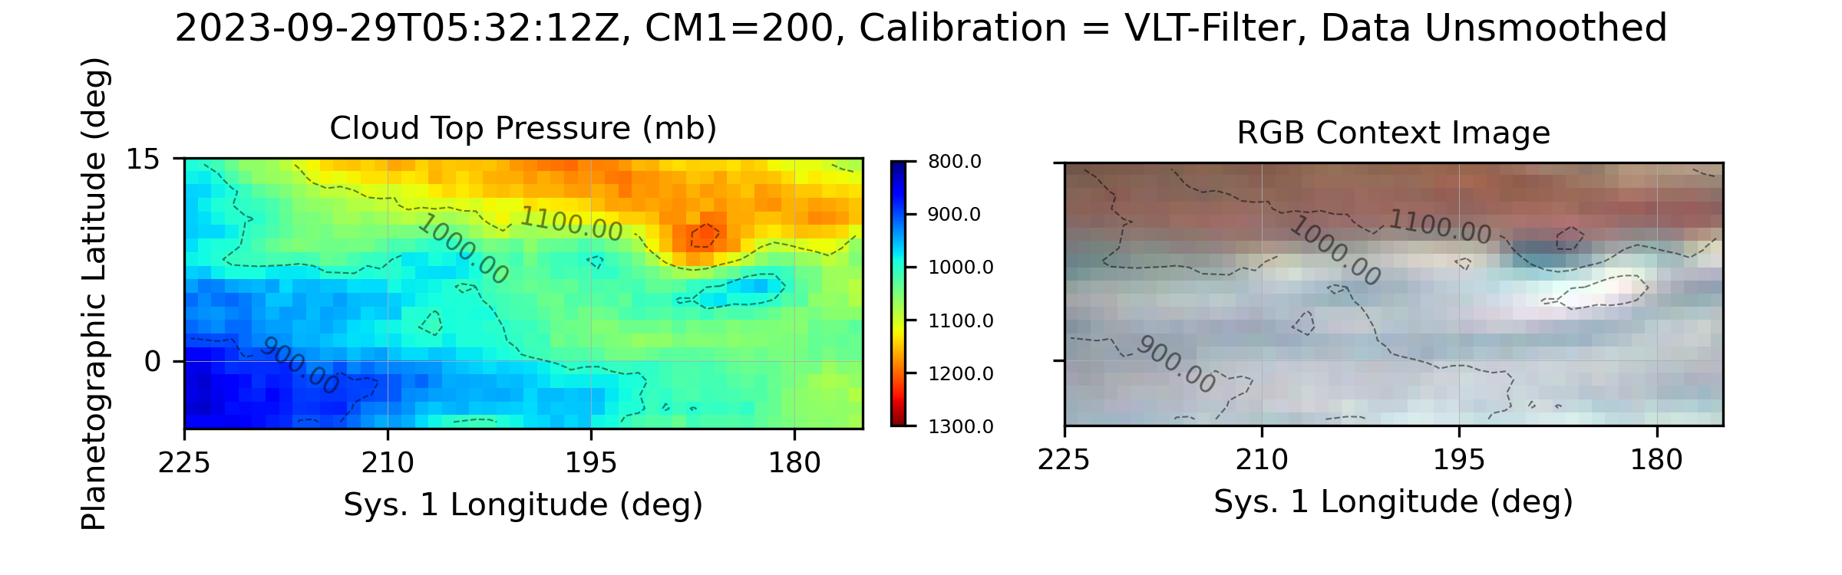
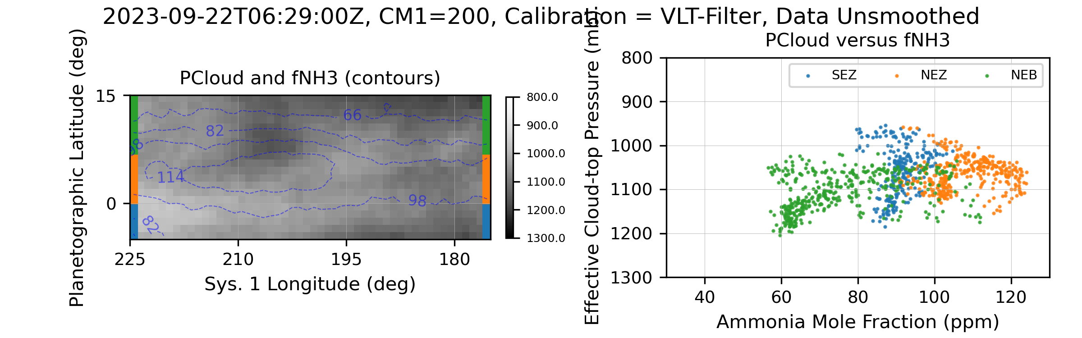
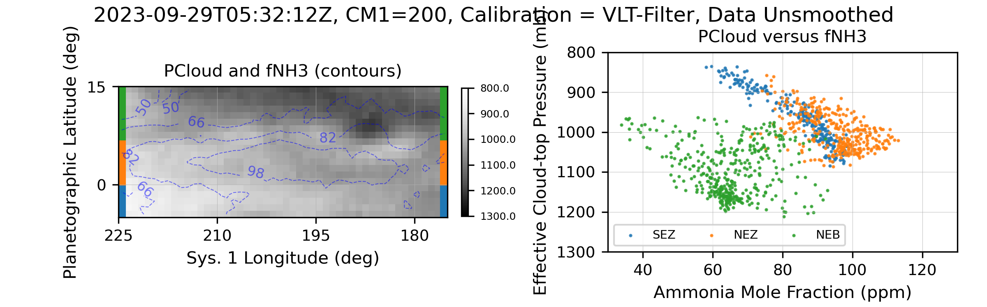
NH₃, CH₄, and NEDFs Candidates for Study
Time Evolution: ~200 deg from August to October (possibly connected to Feb 2024 observations)
~220 deg same time period
Nov 13 ~350 deg

Slide 13
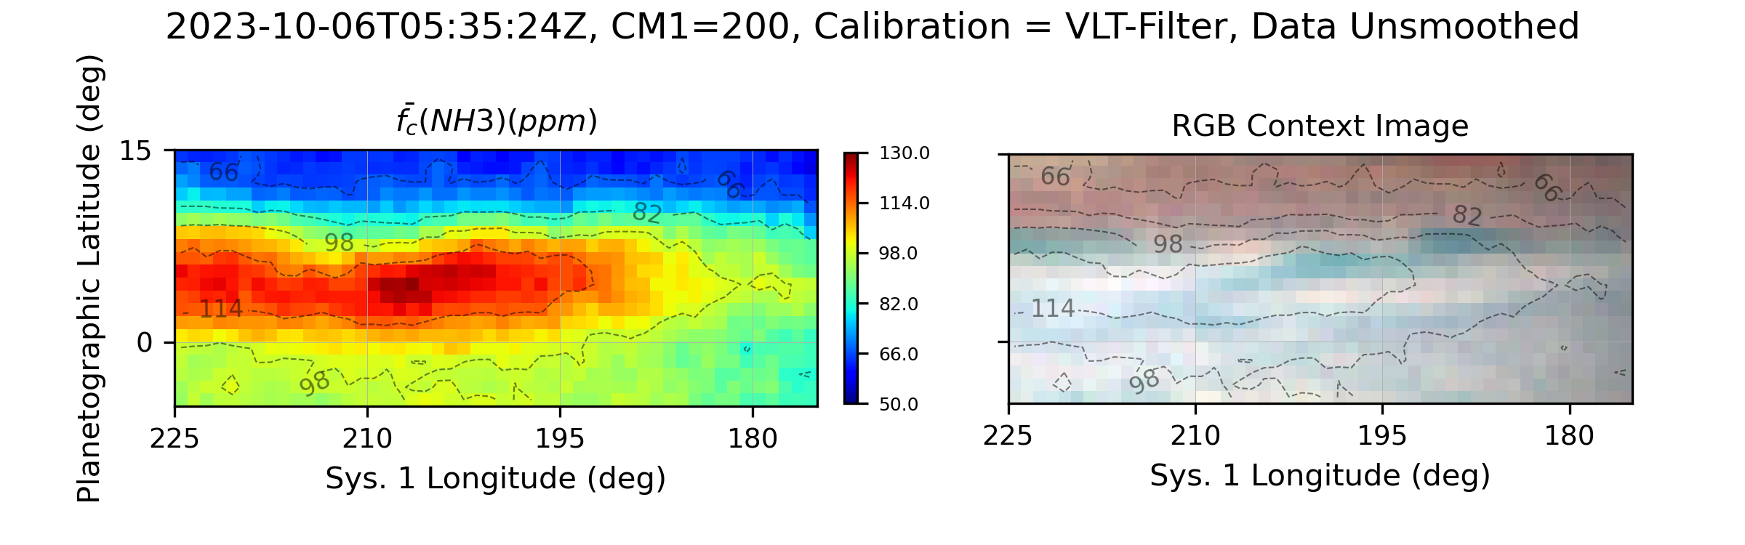
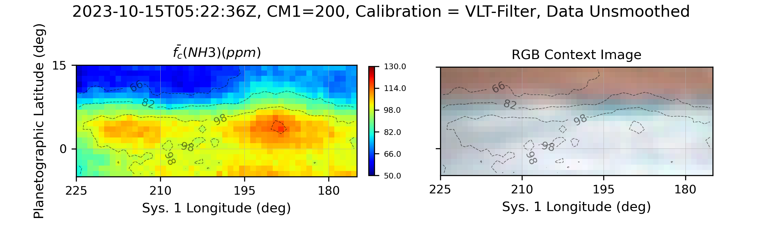
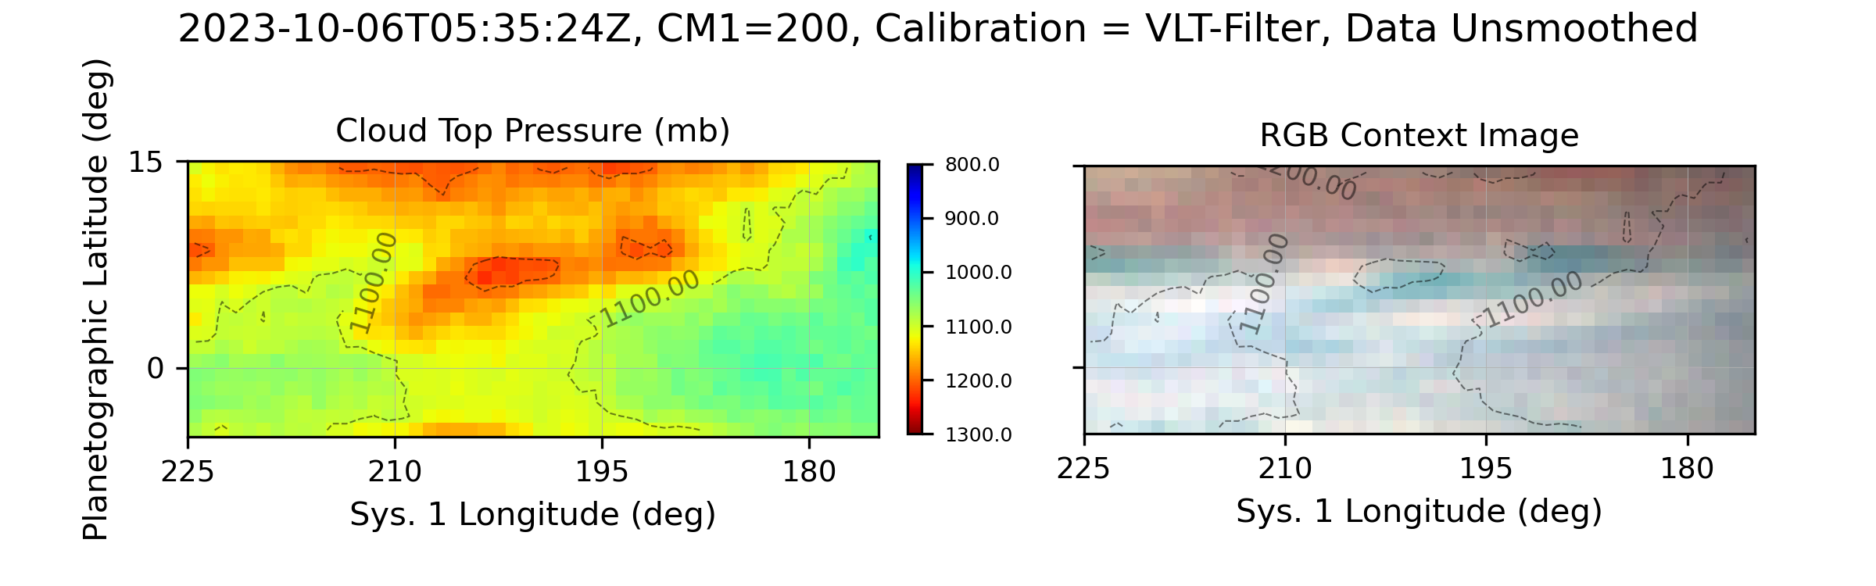
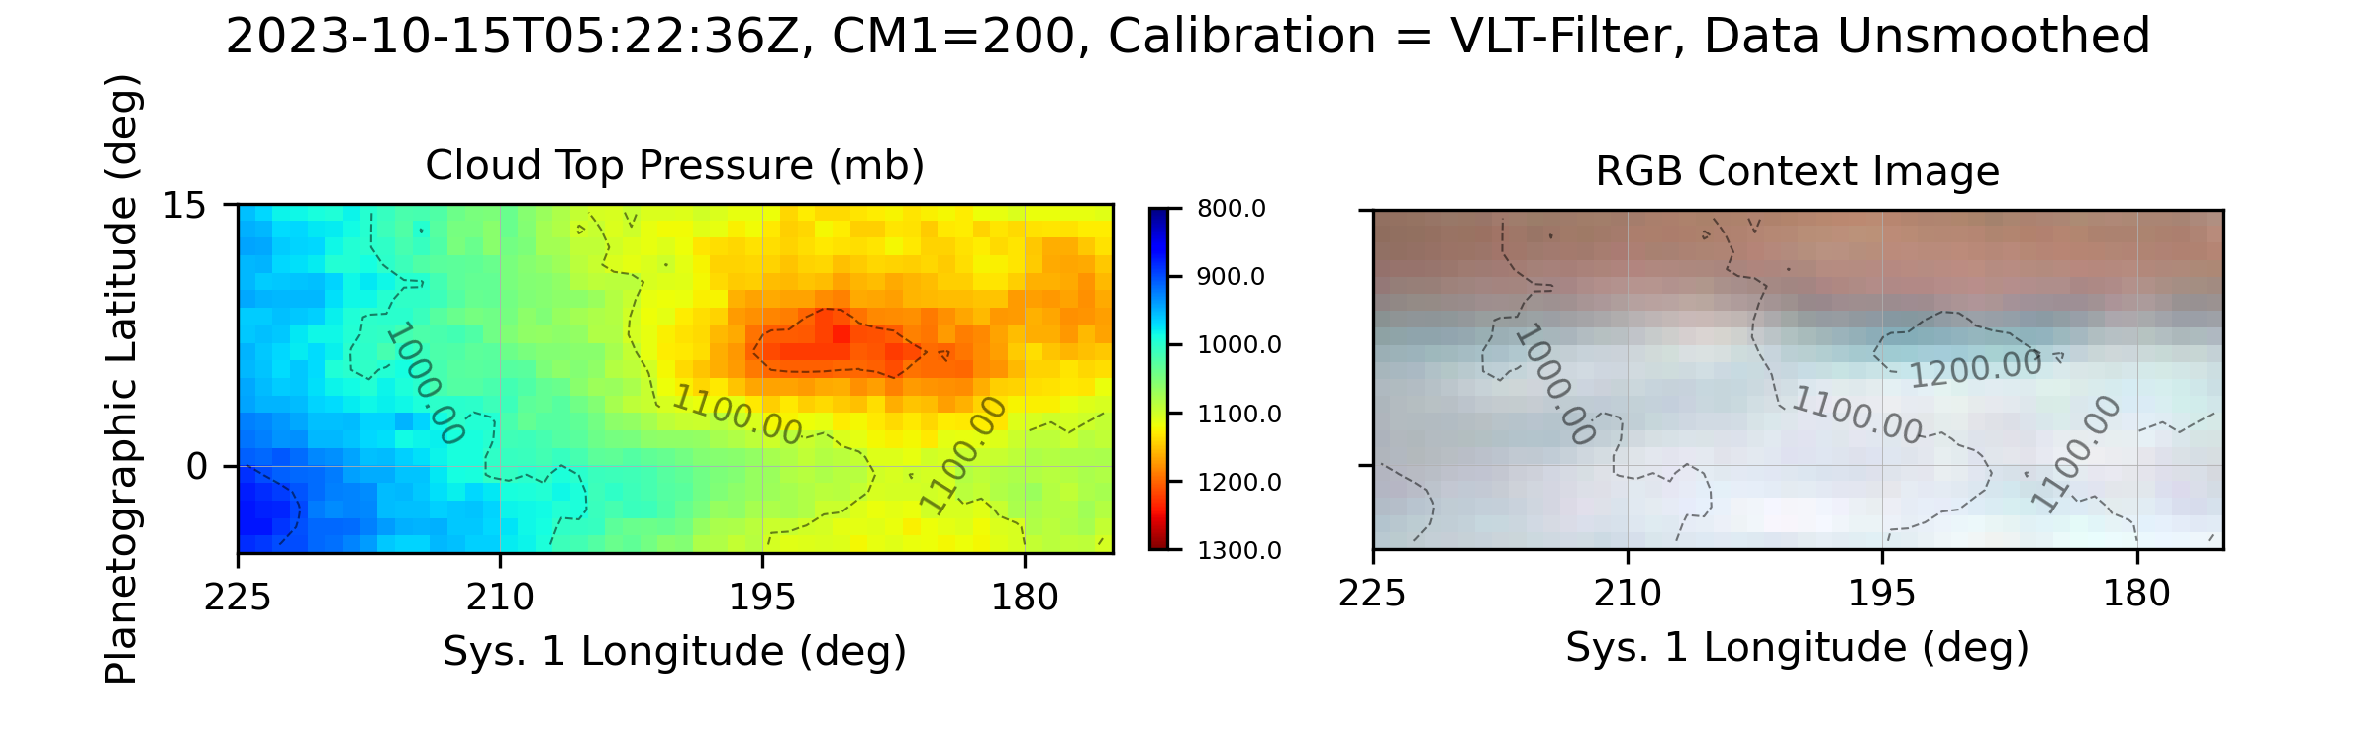
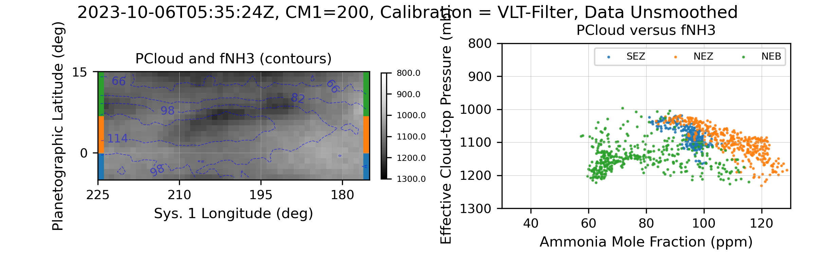
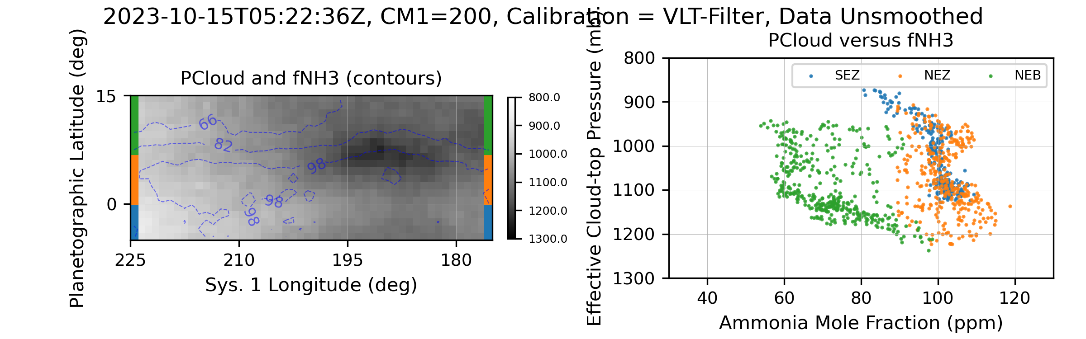
NH₃, CH₄, and NEDFs Candidates for Study
Time Evolution: ~200 deg from August to October (possibly connected to Feb 2024 observations)
~220 deg same time period
Nov 13 ~350 deg

Slide 14
Limb Correction and Synoptic Maps
Hypothesis: TBD
NH3 enhancements tracked relative to NEDFs over time
Show evolution of NEDF-NH3 couple

